Slide 1
Get help with exam results careers advice. Stakeholder toolkit

Slide 2
Introduction
The National Careers Service runs Get help with exam results careers advice in August, to support young people and their parents/ carers with free careers advice after they receive their exam results.
The National Careers Service offer includes:
Exam related content on the website
Webchat with an expert careers adviser, accessible via the website
A free helpline where you’ll be put through to a professional careers adviser in your local area
Top tips and live Q&A sessions run through the service’s social media channels
This toolkit contains copy and social media posts that you can use on your own channels to promote the National Careers Service office with your own audiences. If you need any further information or content, then please contact Laura.CapesReed@education.gov.uk

Slide 3
Suggested copy for newsletters, emails, social channels.
Get help with exam results careers advice
The National Careers Service will be providing exam results careers advice in August. Support is available to both young people and their parents/ carers through exam specific content on the National Careers Service website, social media, webchat and by phone.
You can contact the helpline on 0800 100 900 from Thursday 17th August until Friday 1st September 2023, from 8am – 8pm Monday to Friday and 10am – 5pm Saturday.
Professionally qualified careers advisers will be available to help both young people and those supporting them with advice on their next steps after receiving results – whether their results were what they expected or not.

Slide 4
Suggested social media posts
Whatever your results, @NationalCareers expert advisers can help you explore your next steps. Call the helpline on 0800 100 900 or search National Careers Service online #AskNationalCareers #ExamResults2023
Get help with exam results careers advice from @NationalCareers. Call the helpline on 0800 100 900 or search National Careers Service online #AskNationalCareers #ExamResults2023
Have you had exam results? The National Careers Service expert advisers are here to help you with your next steps via webchat and phone – call 0800 100 900 or search National Careers Service online #AskNationalCareers #ExamResults2023

Slide 5
Messages by audience
Young people:
If you’ve had your exam results and would like to chat to an expert careers adviser about your next steps, then the National Careers Service is here to help. You can chat to an adviser online through our website or call us on 0800 100 900.
Whether you did better or worse than expected, the National Careers Service expert advisers are here to chat to you about taking the next step in your future career. You can visit our website, chat to us via website or give an adviser a call on 0800 100 900.
Parents/ carers:
If you care for a young person that has had their exam results and would like help in supporting them with the next steps in their future career, the National Careers Service is here to help. You can visit our website for more information, chat to an adviser via webchat or phone 0800 100 900.

Slide 6
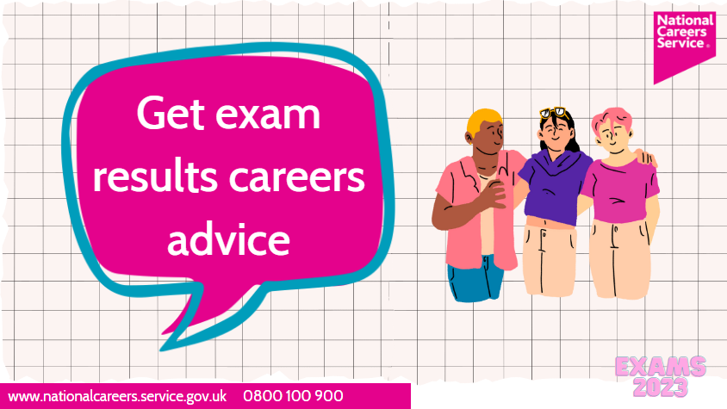
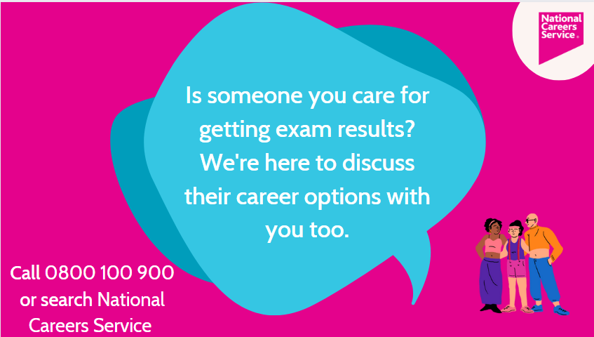
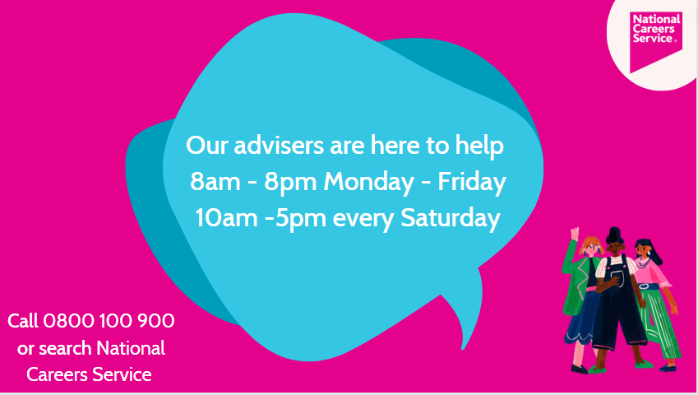
Assets for use on social channels

Slide 7
Contact details/ useful links
0800 100 900
National Careers Service
Exam results | National Careers Service
Parent's guide to exam results | National Careers Service
Exams in 2023 – everything you need to know - The Education Hub (blog.gov.uk)

